Slide 1

Gokaraju Rangaraju Institute of Engineering and Technology
(Autonomous)
Department of CSE(AI&ML)
Mini Project With Seminar
TITLE
Under the Guidance of:
Dr. M. Shamila,
Assistant Professor,
GRIET
Presented by:
1. A Anirudh Sharma (23241A6602)
2. Palvai Danny (23241A6602)
3. V. Sai Suneeth Varma (2425A6607)

Slide 2
Abstract
Reinforcement learning (RL) is a machine learning approach where an agent learns to make decisions by interacting with an environment to maximize cumulative reward. The field has come a long way since then, evolving and maturing in several directions. Reinforcement learning has gradually become one of the most active research areas in machine learning, artificial intelligence, and neural network research.
This research explores the application of Deep Q-Network (DQN) algorithms to the problem of optimizing chess piece movement, a fundamental aspect of chess strategy. This work aims to develop an AI agent capable of making precise and effective moves.
The DQN algorithm is utilized to approximate the optimal Q-values for each possible movement, allowing the agent to learn the best actions from given board states. Training is conducted through self-play, where the agent receives feedback based on the outcomes of its moves, including rewards for advantageous positions and penalties for errors.
This study demonstrates the potential of reinforcement learning in enhancing the tactical capabilities of chess playing-agents

Slide 3
1. Introduction
Chess is a complex strategic game that requires intelligent decision-making and long-term planning.
Traditional chess engines rely on predefined rules and search algorithms, which become computationally expensive as game complexity increases.
Artificial Intelligence (AI), especially Reinforcement Learning (RL), provides a powerful alternative by enabling systems to learn strategies through interaction and experience.
In Reinforcement Learning, an agent learns by trial and error, receiving rewards or penalties based on its actions rather than being explicitly programmed.

Slide 4
1. Introduction (contd…)
This project focuses on Stochastic Chess Piece Movement using Deep Q-Network (DQN).
DQN combines Q-learning with deep neural networks to handle large state and action spaces in chess.
The AI agent learns optimal chess moves by interacting with the environment and improving through self-play.
The goal is to develop an intelligent system capable of making effective chess decisions under uncertainty, demonstrating the potential of deep reinforcement learning in game AI.

Slide 5
2. Problem Statement
Traditional chess engines rely heavily on predefined rules and exhaustive search techniques, which become inefficient when dealing with large state and action spaces.
Chess involves uncertainty and stochastic decision-making, where optimal moves depend on long-term outcomes rather than immediate rewards.
Conventional Q-learning methods struggle to scale due to the enormous number of possible board states and legal moves.
Therefore, there is a need for an intelligent approach that can learn optimal chess piece movements autonomously, handle stochastic environments, and efficiently manage high-dimensional state spaces.
This project addresses the problem by applying Deep Q-Networks (DQN) to learn and optimize chess piece movements through reinforcement learning.

Slide 6
3. Objectives of the Project
To design and implement a reinforcement learning–based chess agent capable of learning optimal piece movements.
To apply Deep Q-Network (DQN) for handling the large and complex state–action space of chess.
To enable the agent to learn through self-play and interaction with the chess environment.
To balance exploration and exploitation for effective decision-making under uncertainty.
To evaluate the effectiveness of DQN in improving chess move selection and overall gameplay performance.

Slide 7
4. Literature Survey (Existing Approaches)c
Reference Number | Title | Methodology | Results/Remarks
[1] | Superior Computer Chess with Model Predictive Control, Reinforcement Learning, and Rollout | Combines model predictive control (MPC), reinforcement learning (RL), and rollout planning with existing chess engines to create a meta-algorithm that uses position evaluation and opponent prediction to select moves | Shows that RL-based planning improves decision-making in complex chess environments, supporting the use of DQN for evaluating stochastic chess piece movements.
[2] | Model Predictive Control and Reinforcement Learning: A Unified Framework Based on Dynamic Programming | Presents a unified framework combining dynamic programming, model predictive control, and reinforcement learning for sequential decision-making problems. | Provides theoretical justification for using Q-value approximation (DQN) in environments with uncertainty and stochastic transitions, such as stochastic chess piece movement.

Slide 8
4. Literature Survey (Existing Approaches) contd…
Reference Number | Title | Methodology | Results/Remarks
[3] | Mastering Chess and Shogi by Self-Play with a General Reinforcement Learning Algorithm | Uses deep neural networks trained via self-play reinforcement learning combined with Monte Carlo Tree Search for move selection | Demonstrates that self-play reinforcement learning can learn strong chess strategies, validating the training approach adopted for stochastic chess piece movement.
[4] | Rainbow: Combining Improvements in Deep Reinforcement Learning | Combines multiple DQN enhancements including Double DQN, prioritized experience replay, dueling networks, and noisy exploration. | Shows improved stability and performance of DQN in complex and stochastic environments, motivating the use of enhanced DQN techniques in the proposed project.

Slide 9
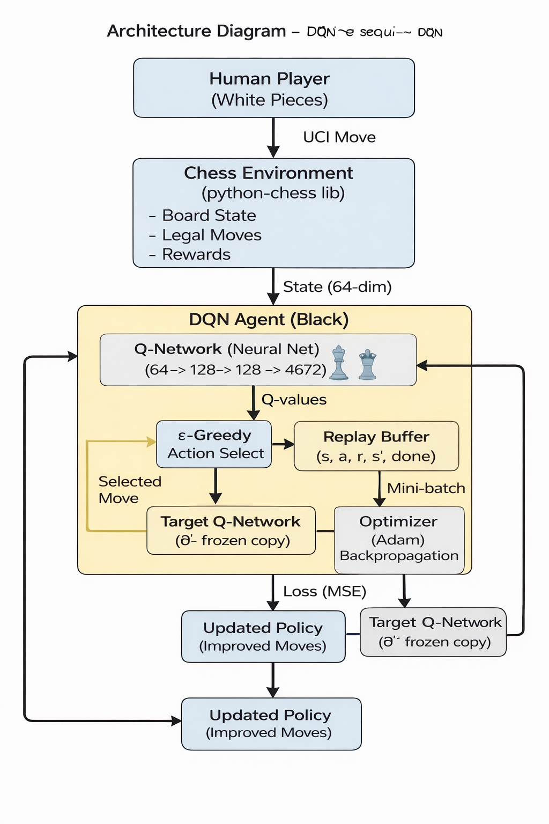
5. Architecture Diagram

Slide 10
Software & Hardware Requirements
Software Requirements
S.No | Action | Purpose
1 | Operating System (Windows / Linux / macOS) | Provides platform to execute and manage the application
2 | Python 3.10.9 | Core programming language for implementing DQN
3 | PyTorch Library | Used to build, train, and optimize the Deep Q-Network model
4 | NumPy | Supports numerical computations and array operations
5 | Python-Chess Library | Provides chessboard representation, legal moves, and game rules

Slide 11
Software & Hardware Requirements (contd…)
Hardware Requirements
S.No | Action | Purpose
1 | Processor (Intel/AMD) | Executes reinforcement learning computations
2 | RAM (Minimum 8 GB) | Stores neural network parameters and replay buffer
3 | Storage (Minimum 20 GB) | Holds software libraries, datasets, and program files
4 | GPU (Optional) | Accelerates deep learning model training
5 | Keyboard & Mouse | Enables user interaction during gameplay
6 | Monitor | Displays chessboard output and results

Slide 12
References
Richard S. Sutton and Andrew G. Barto, Reinforcement Learning: An Introduction, MIT Press, Cambridge, MA, 2018.
YouTube Playlist, Reinforcement Learning Tutorials
Available at: https://youtube.com/playlist?list=PLqYmG7hTraZDM-OYHWgPebj2MfCFzFObQ
ChatGPT-3.5, OpenAI
Available at: https://chat.openai.com/
Medium Articles, Reinforcement Learning and Deep Learning Concepts
Available at: https://medium.com/
Bharti Motwani, Data Analytics Using Python, Pearson Education.
H.K. Das, Higher Engineering Mathematics, S. Chand Publishing.

